Slide 1
Calculator Project with Verilog
By Roman revzin

Slide 2
Basic operations
Addition/Subtraction
Signed Multiplication
Signed Division

Slide 3
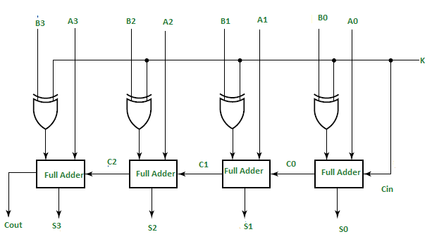
Addition/Subtraction
Adder Subtractor acts like a regular 4-bit adder, but has carry in control bit to determine the operation. If the control is low, XOR doesn’t affect 2nd addend, else perform 2’s complement with 1’s complement of the input and adding value of control bit. If the result has to be negative, performs 2’s complement again.

Slide 4
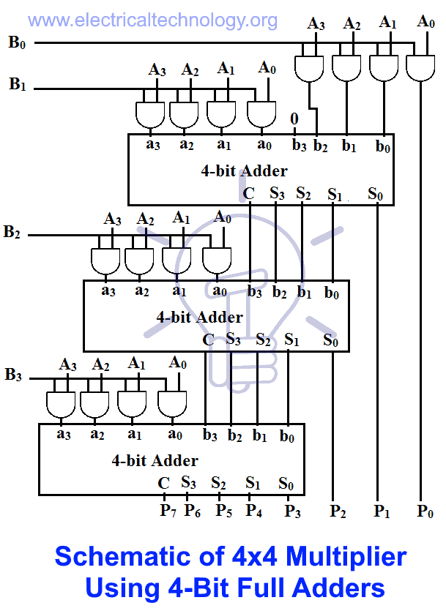







Signed Multiplication
4-by-4 multiplication is performed by three 4-bit adder/subtractor with driven 1 control bit to set the working mode to addition. Supports signed multiplication. Check final sign with XOR on MSBs and making 2’s complement of negative factors to perform regular unsigned multiplication.

Slide 5
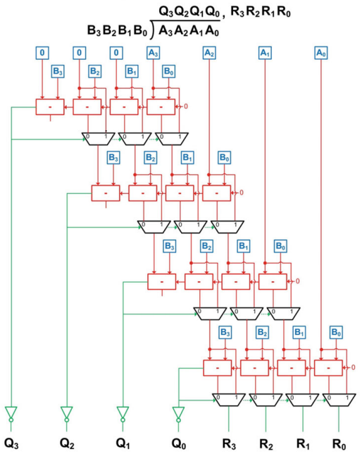
Signed Division
4-by-4 signed divider performed with “iterative subtraction method”. Multiple adder/subtractor with driven 0 control bit and MUXs allow to bring the algorithm on logical circuits. Supports signed division in the same way as multiplier above. Both quotient and remainder are negative to allow recreating initial value properly. Has zero division indicator.

Slide 6
Extra operations
Shifter (1 cycle combinational circuit/multiple cycle sequential circuit)
Arithmetic Shifter (1 cycle combinational circuit/ multiple cycle sequential circuit)
Rotator Shifter (1 cycle combinational circuit/ multiple cycle sequential circuit)
Modulus
Comparator/Cascading comparator

Slide 7
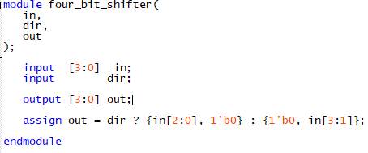
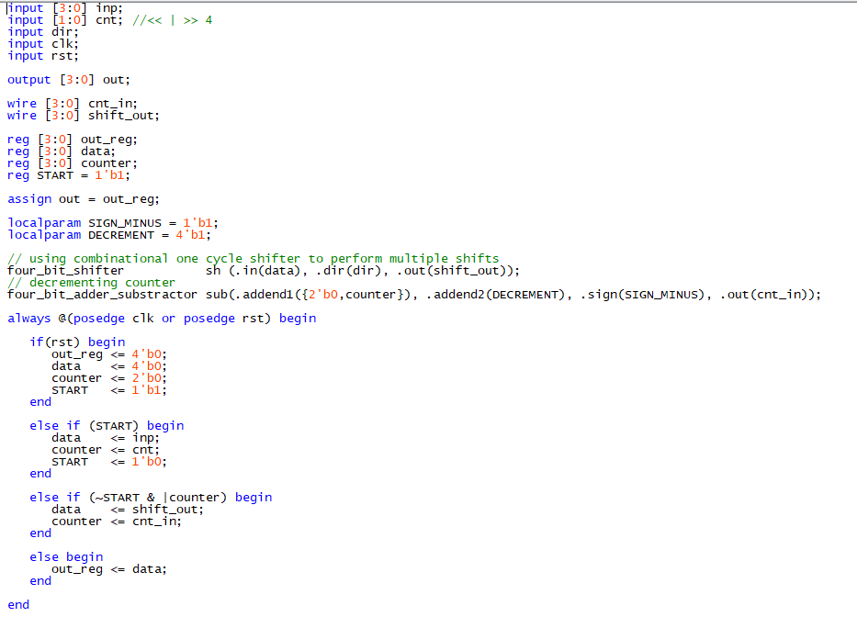
Shifter
Shifter performs 1 shift. Direction set with “dir” control bit.
Full shifter uses shifter to perform multiple shifts.

Slide 8
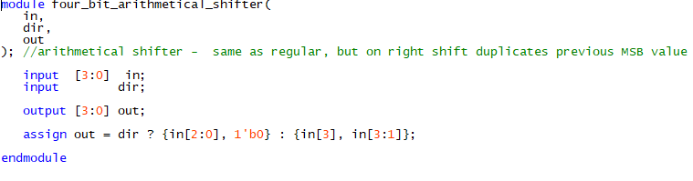
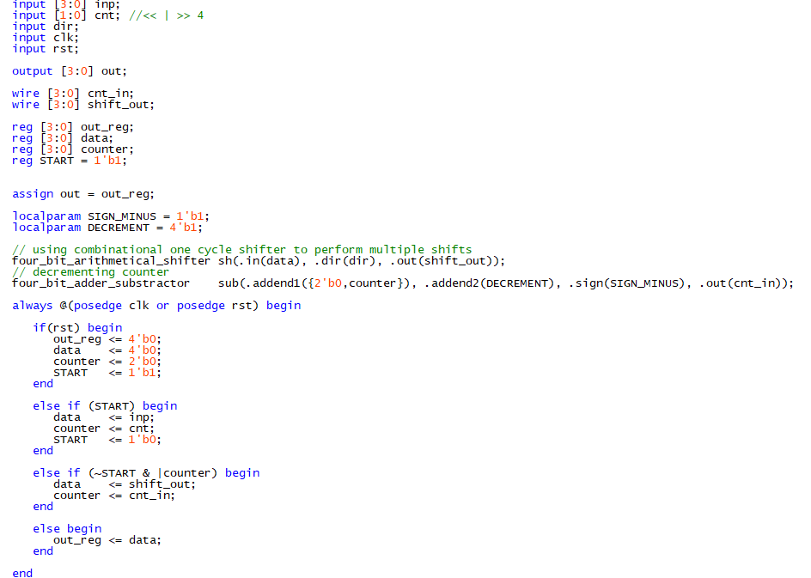
Arithmetical shifter
Same as regular shifters, but duplicates MSB on right shift, instead of zero padding.

Slide 9
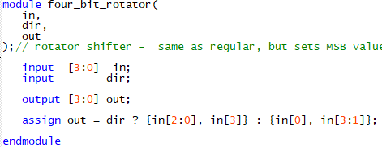
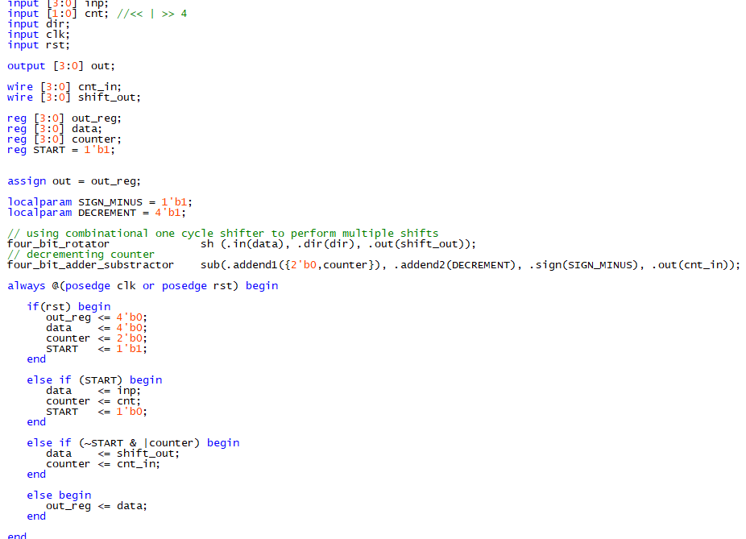
Rotator Shifter
Same as regular shifters, but sets MSB to LSB on right shift and vice versa.

Slide 10
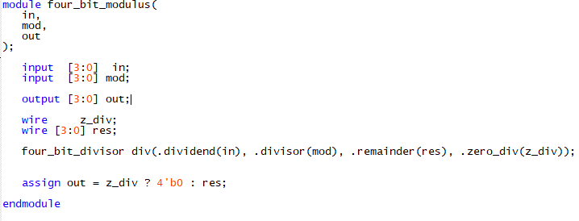
Modulus
Uses divider and returns remainder of division. If the input was negative, remainder will be negative as well. If divisor was 0, zero returned.

Slide 11
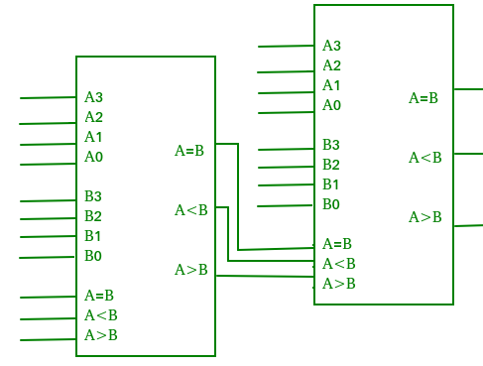
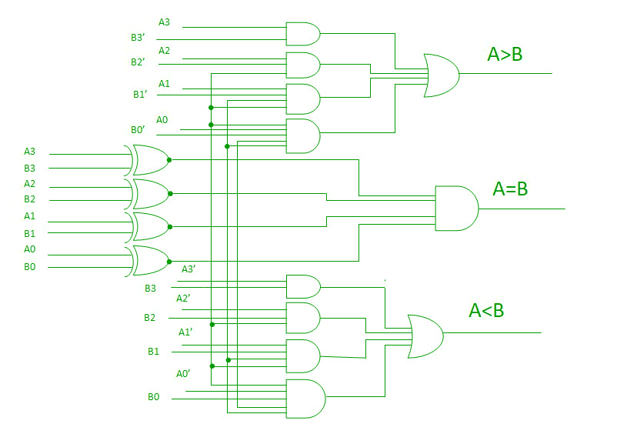
Comparator
Comparator – check whether input A greater, equal or less than input B.
Cascading comparator – has three additional input indicating previous results. Allows cascading multiple modules to widen inputs. First cascade has to be driven with 0 on greater/less and 1 on equal to perform correct comparisons.

Slide 12
Performance
Except the full shifters, all the circuit are combinational.
Since there are no propagation delays, time needed to perform any calculation is negligible(immediate result, 0 cycles), which makes them much faster that sequential ones.
Time needed for shifters to finish calculation is 1 + n, where n is amount of shifts to perform and 1 extra cycle for setup.

Slide 13
Notes
There are no control units to choose whether the modules work in signed or unsigned mode. Unsigned set to show the ability to work with negative. The build is flexible for extensions.
Every module has 1 or 2 4-bit input(except 8-bit adder/subtractor which is for inner use), number of control bits and 4 – bit outputs(except multiplier, which has 8-bit and comparators, which have 3 1-bit outputs).
For some unknown reason, counter increment in top module doesn’t work, thus it’s disabled. Use only decrement to change modes.

